Slide 1
Bloch Sphere
https://javafxpert.github.io/grok-bloch/

Slide 2
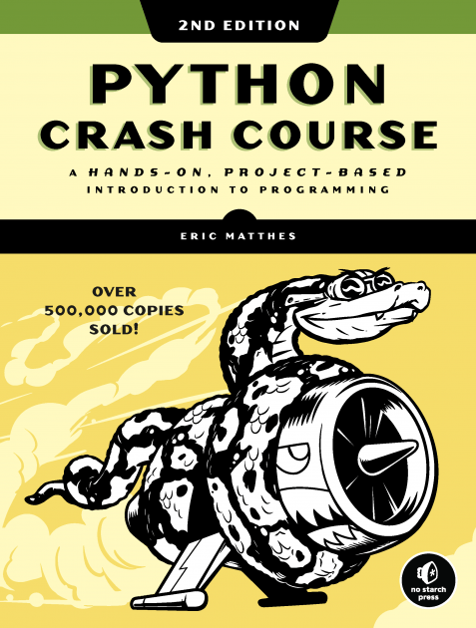
New in Python ?

Slide 3
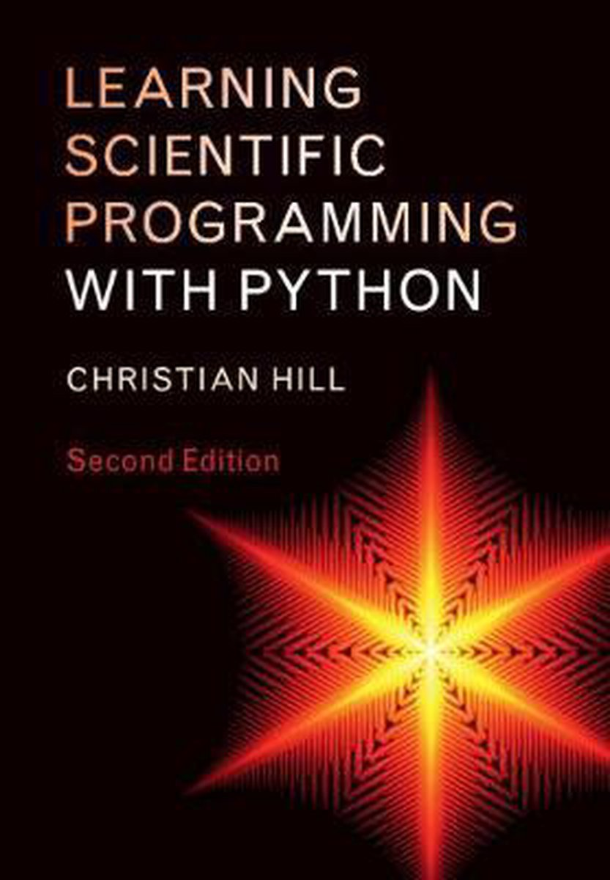
Scientific programming in Python

Slide 4
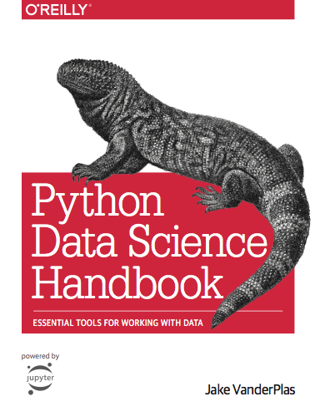
Working with data in Python

Slide 5
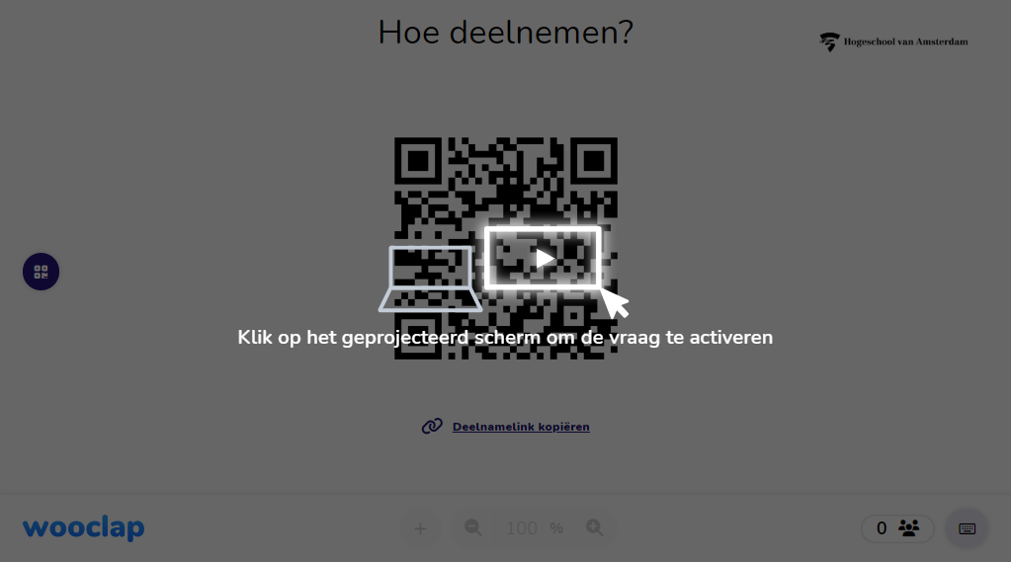
Python Skills ?

Slide 6
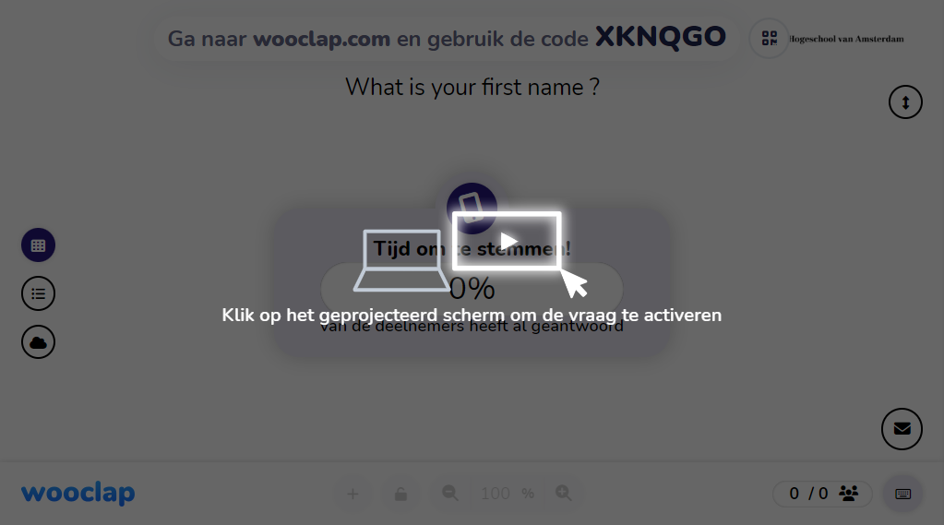
Python Skills ?

Slide 7

Python Skills ?

Slide 8
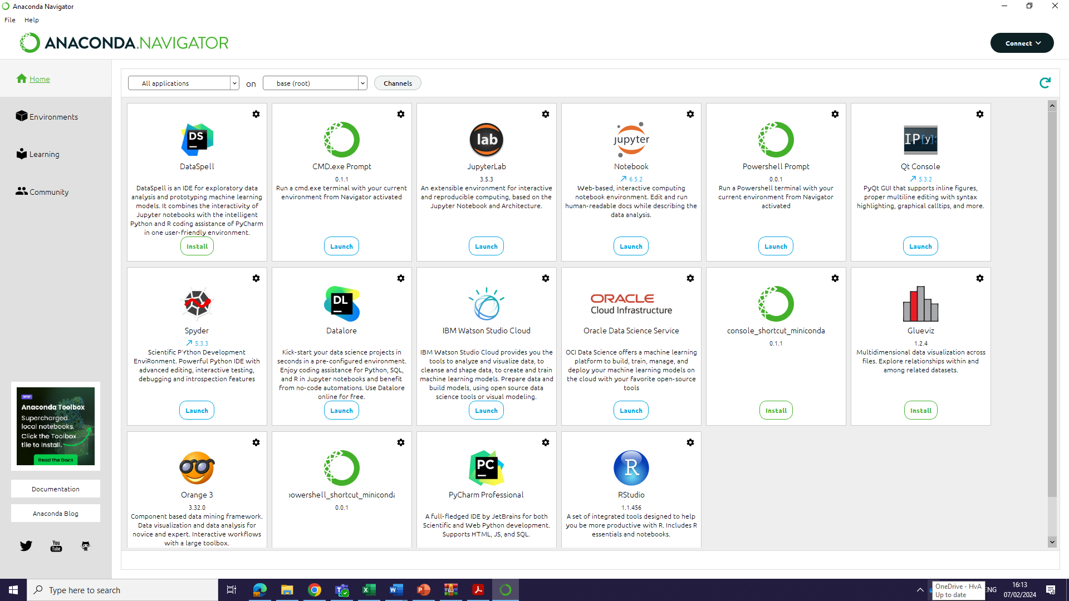
Anaconda environment

Slide 9
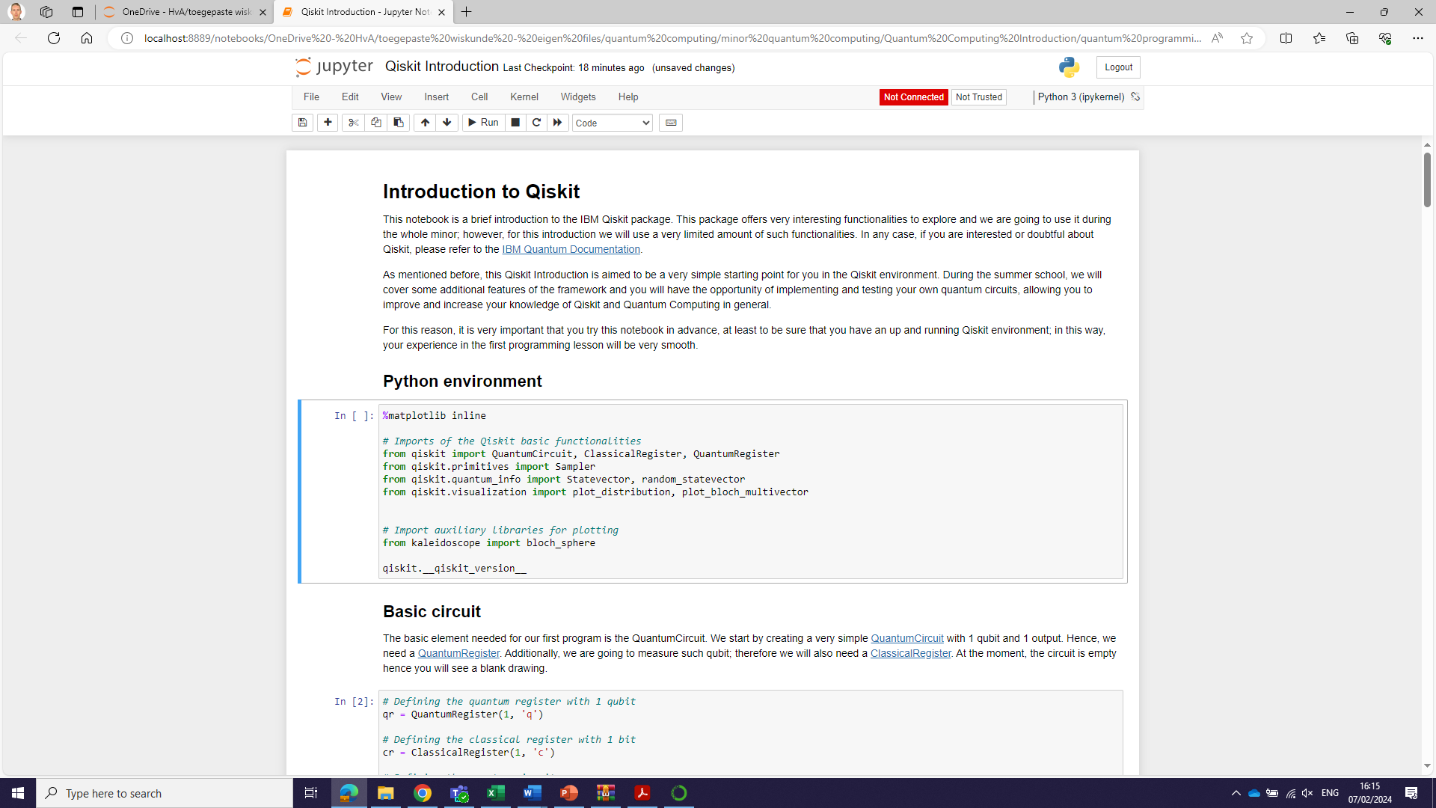
Jupyter Notebook
https://www.edureka.co/blog/wp-content/uploads/2018/10/Jupyter_Notebook_CheatSheet_Edureka.pdf

Slide 10
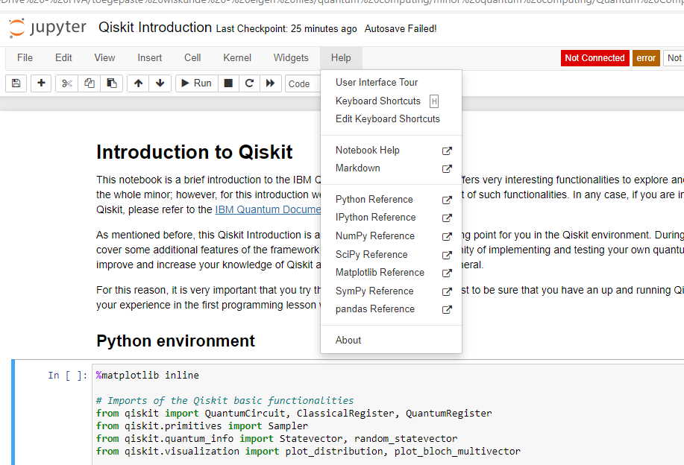
Documentation
Qiskit https://docs.quantum.ibm.com/api/qiskit

Slide 11
Python introduction
https://www.w3schools.com/python/
Syntax
Comments
Variables
Data Types
Numbers
Strings
Booleans
Operators
Lists
Dictionaries
Arrays
If … Else
While
For
Functions
Modules
Numpy
Linear algebra (numpy.linalg) — NumPy v1.26 Manual
Matplotlib line
Matplotlib scatter

Slide 12
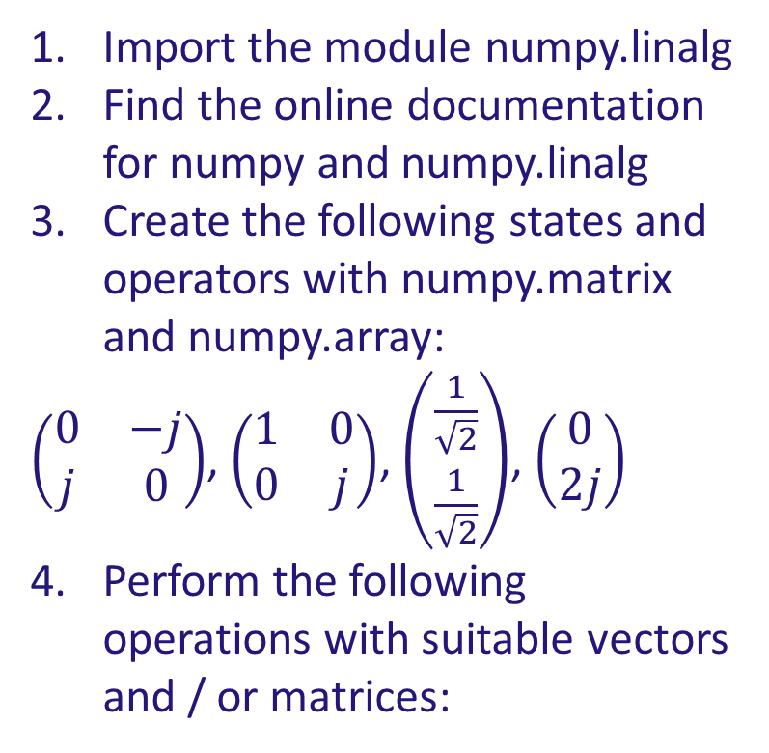
Assignment numpy
Import the module numpy.linalg
Find the online documentation for numpy and numpy.linalg
Create the following states and operators with numpy.matrix and numpy.array:
$\left(\begin{matrix}0 & −j \\ j & 0\end{matrix}\right)$, $\left(\begin{matrix}1 & 0 \\ 0 & j\end{matrix}\right)$, $\left(\begin{matrix}\frac{1}{\sqrt{2}} \\ \frac{1}{\sqrt{2}}\end{matrix}\right)$, $\left(\begin{matrix}0 \\ 2j\end{matrix}\right)$
Perform the following operations with suitable vectors and / or matrices:
Length of a vector
Normalized vector
Complex conjugate of a vector
Dot product of two vectors
Transpose of matrix
Inverse of matrix
Matrix-vector multiplication
Tensor product (Kronecker product)
Eigenvalues of a matrix
Eigenvectors of a matrix

Slide 13
Simulating circuits on your computer:
Qiskit: https://www.qiskit.org/
Cirq: https://github.com/quantumlib/cirq
Pennylane: https://pennylane.ai/
Quantum Machine Learning: https://www.qmlcode.org/
Quantum TensorFlow (hybrid ML): https://www.tensorflow.org/quantum

Slide 14
The Real Deal:
Quantum Inspire: https://www.quantum-inspire.com/
Rigetti Forest SDK: https://pyquil-docs.rigetti.com/en/stable/
IBM Quantum experience: https://quantum-computing.ibm.com/

